Slide 1


Clean, Transform, and Load Data In Power BI
Please mute yourself. Thank you!

Slide 2
Learning Objectives
You will learn the following concepts:
Power Query Editor /Transformations
Data Cleanup
Merge Operation
Append Operation
Calculations using M-Language
Notes:
By the end of this module, you’ll be able to:
Profile the data
Shape the data
Enhance the structure of the data

Slide 3

Introduction
Benefits of clean data:
More accurate results
Better organized tables
Simpler data navigation
Human-readable values
Notes:
Consider the scenario where you have imported data into Power BI from several different sources and, when you examine the data, it is not prepared for analysis. What could make the data unprepared for analysis? Dirty data can be overwhelming and, though you might feel frustrated, you decide to get to work and figure out how to make this data model as pristine as possible.
Clean data has the following advantages:
Measures and columns produce more accurate results when they perform aggregations and calculations.
Tables are organized, where users can find the data in an intuitive manner.
Duplicates are removed, making data navigation simpler. It will also produce columns that can be used in slicers and filters.
Codes and integers can be replaced with human readable values.
A complicated column can be split into two, simpler columns. Multiple columns can be combined into one column for readability.

Slide 4
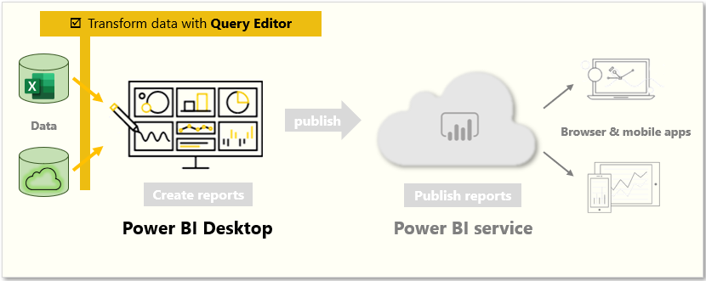
Identify column headers and names
Use Power Query Editor to clean up and shape data.
Notes:
Power Query Editor in Power BI Desktop allows you to shape (transform) your imported data. You can accomplish actions such as renaming columns or tables, changing text to numbers, removing rows, setting the first row as headers, and much more. It is important to shape your data to ensure that it meets your needs and is suitable for use in reports.
Get started with Power Query Editor
To start shaping your data, open Power Query Editor by selecting the Transform data option on the Home tab of Power BI Desktop. When you work in Power Query Editor, all steps that you take to shape your data are recorded. Then, each time the query connects to the data source, it automatically applies your steps, so your data is always shaped the way that you specified.
Identify column headers and names
The first step in shaping your initial data is to identify the column headers and names within the data and then evaluate where they are located to ensure that they are in the right place.

Slide 5
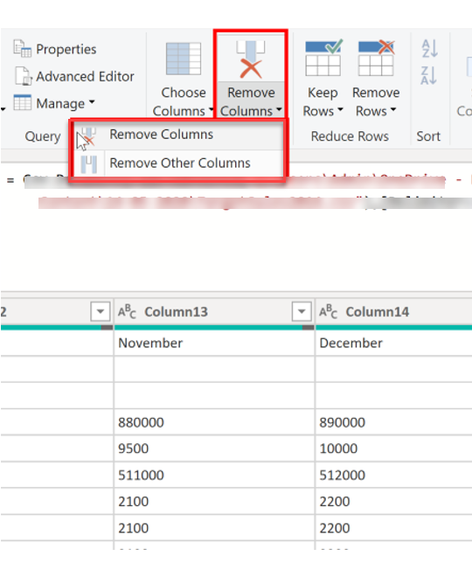
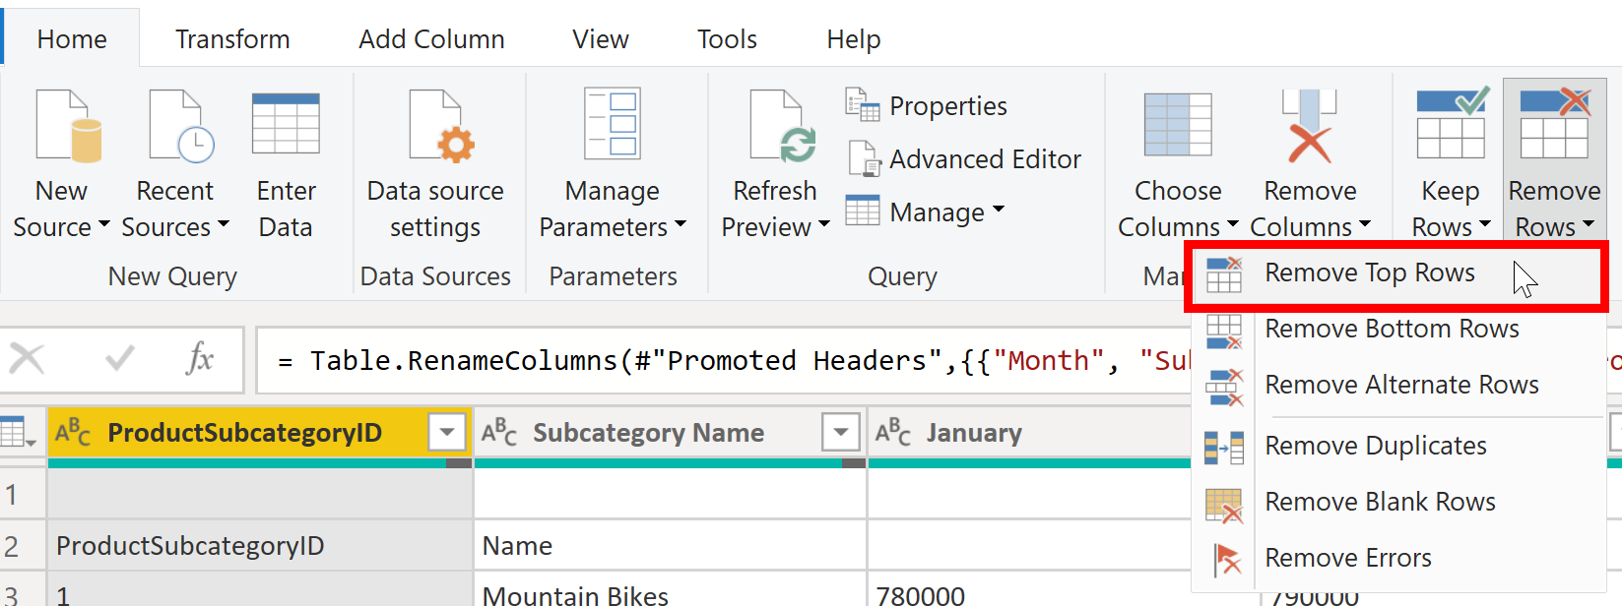
Shaping Table Structure
Deleting unnecessary rows and columns will reduce a dataset size thereby will improve the performance
Shape the data to meet reporting needs.
Notes:
With Power BI Desktop, you can connect to many different types of data sources, then shape the data to meet your needs, enabling you to create visual reports to share with others. Shaping data means transforming the data: renaming columns or tables, changing text to numbers, removing rows, setting the first row as headers, and so on.
Promote headers
When a table is created in Power BI Desktop, Power Query Editor assumes that all data belongs in table rows. However, a data source might have a first row that contains column names, which is what happened in the previous SalesTarget example. To correct this inaccuracy, you need to promote the first table row into column headers.
Rename columns
The next step in shaping your data is to examine the column headers. You might discover that one or more columns have the wrong headers, a header has a spelling error, or the header naming convention is not consistent or user-friendly.
Remove top rows
When shaping your data, you might need to remove some of the top rows, for example, if they are blank or if they contain data that you do not need in your reports.
Remove columns
A key step in the data shaping process is to remove unnecessary columns. It is much better to remove columns as early as possible. Removing columns at an early stage in the process rather than later is best, especially when you have established relationships between your tables.

Slide 6
Review Questions (1)
Q01 – What is primary data preparation tool in Power BI is called?
A01 – Power Query Editor
Q02 – What can be achieved by removing unnecessary rows and columns?
A02 – Deleting unnecessary rows and columns will reduce a dataset size and its good practice to load only necessary data into your data model.
Q03 – What is Merge operation in power BI?
A03 –A merge queries operation joins two existing tables together based on matching values from one or multiple columns.

Slide 7
Lesson 2: Profiling the Data

Slide 8
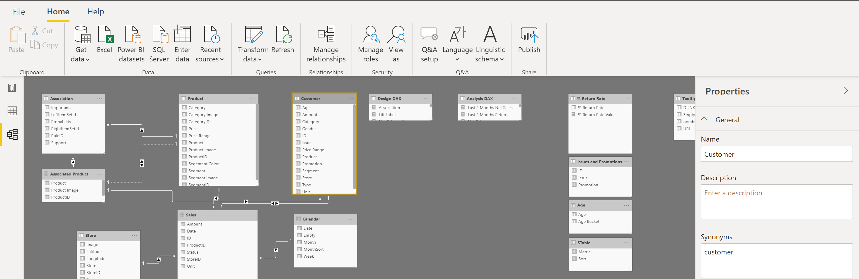
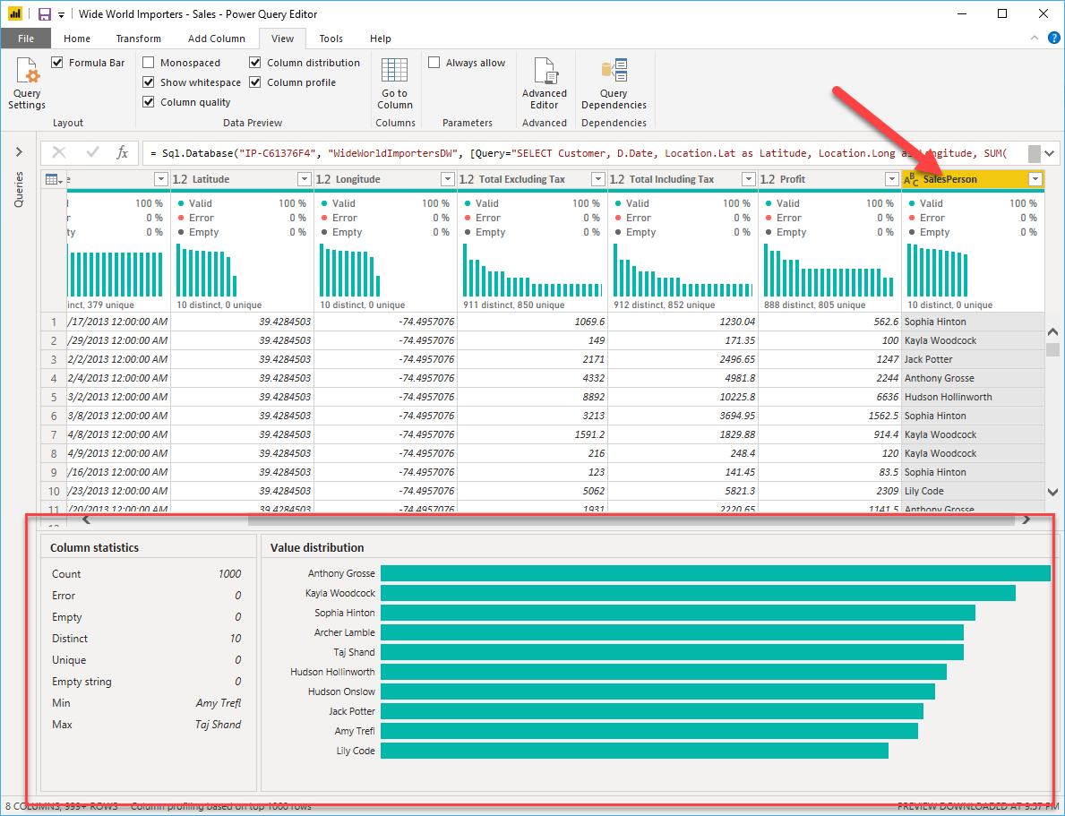
Profiling Data and Examining Structures
Data profiling is understanding the state and structure of the data you are working with.
Notes:
Profiling data is about studying the nuances of the data: determining anomalies, examining and developing the underlying data structures, and querying data statistics such as row counts, value distributions, minimum and maximum values, averages, and so on. This concept is important because it allows you to shape and organize the data so that interacting with the data and identifying the distribution of the data is uncomplicated, therefore helping to make your task of working with the data on the front end to develop report elements near effortless.
Examine data structures
Before you begin examining the data in Power Query Editor, you should first learn about the underlying data structures that data is organized in. Profiling data occurs either prior to or in parallel to data shaping.
<CLICK>
Find data anomalies and data statistics
After you have created a connection to a data source and have selected Transform Data, you are brought to Power Query Editor, where you can determine if anomalies exist within your data. Data anomalies are outliers within your data.
Column distribution shows you the distribution of the data within the column
Column profile gives you more details about the data in the column, including basic statistics.
The Value distribution graph tells you the counts for each unique value in that specific column.
Column Statistics will also include how many zeroes and null values exist, along with the average value in the column, the standard deviation of the values in the column, and how many even and odd values are in the column.

Slide 9
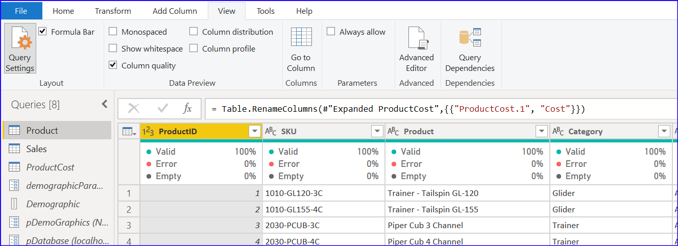
Profiling Data and Examining Structures
Column Quality:
The information provided includes the number of Error, Empty, and Valid data cells in that column and their percentage.
There is a simpler way to see this for all columns in the table. You can enable the Column Quality in the View tab in the Power Query Editor
Notes:
Profiling data is about studying the nuances of the data: determining anomalies, examining and developing the underlying data structures, and querying data statistics such as row counts, value distributions, minimum and maximum values, averages, and so on. This concept is important because it allows you to shape and organize the data so that interacting with the data and identifying the distribution of the data is uncomplicated, therefore helping to make your task of working with the data on the front end to develop report elements near effortless.
Examine data structures
Before you begin examining the data in Power Query Editor, you should first learn about the underlying data structures that data is organized in. Profiling data occurs either prior to or in parallel to data shaping.
<CLICK>
Find data anomalies and data statistics
After you have created a connection to a data source and have selected Transform Data, you are brought to Power Query Editor, where you can determine if anomalies exist within your data. Data anomalies are outliers within your data.
Column distribution shows you the distribution of the data within the column
Column profile gives you more details about the data in the column, including basic statistics.
The Value distribution graph tells you the counts for each unique value in that specific column.
Column Statistics will also include how many zeroes and null values exist, along with the average value in the column, the standard deviation of the values in the column, and how many even and odd values are in the column.

Slide 10
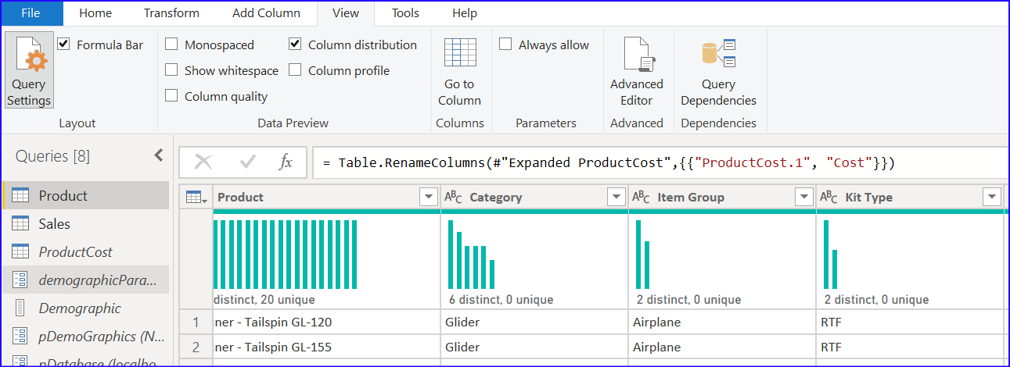
Profiling Data and Examining Structures
Column Distribution
Indicates How the values are spread
Unique vs Distinct
“Distinct” means total number of different values regardless how many times it appears in the dataset. A name appears in the list multiple times is counted as 1 distinct count.
“Unique” value is total number of values that only appear once.
Notes:
Profiling data is about studying the nuances of the data: determining anomalies, examining and developing the underlying data structures, and querying data statistics such as row counts, value distributions, minimum and maximum values, averages, and so on. This concept is important because it allows you to shape and organize the data so that interacting with the data and identifying the distribution of the data is uncomplicated, therefore helping to make your task of working with the data on the front end to develop report elements near effortless.
Examine data structures
Before you begin examining the data in Power Query Editor, you should first learn about the underlying data structures that data is organized in. Profiling data occurs either prior to or in parallel to data shaping.
<CLICK>
Find data anomalies and data statistics
After you have created a connection to a data source and have selected Transform Data, you are brought to Power Query Editor, where you can determine if anomalies exist within your data. Data anomalies are outliers within your data.
Column distribution shows you the distribution of the data within the column
Column profile gives you more details about the data in the column, including basic statistics.
The Value distribution graph tells you the counts for each unique value in that specific column.
Column Statistics will also include how many zeroes and null values exist, along with the average value in the column, the standard deviation of the values in the column, and how many even and odd values are in the column.

Slide 11
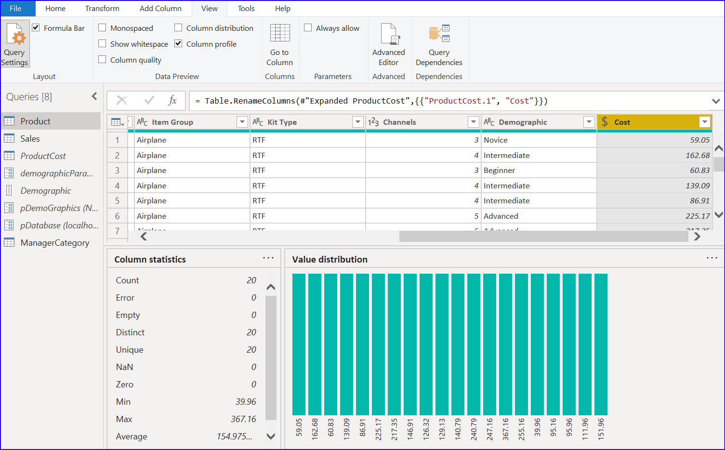
Profiling Data and Examining Structures
Column Profile: In fact, the column profile is a much more complete version of the other two options. It
includes the count of errors and empty values
It also includes the distribution of values in the column.
It also includes statistical information such as the minimum, and the maximum values, count of unique values, and the distribution of values in detail.
Notes:
Profiling data is about studying the nuances of the data: determining anomalies, examining and developing the underlying data structures, and querying data statistics such as row counts, value distributions, minimum and maximum values, averages, and so on. This concept is important because it allows you to shape and organize the data so that interacting with the data and identifying the distribution of the data is uncomplicated, therefore helping to make your task of working with the data on the front end to develop report elements near effortless.
Examine data structures
Before you begin examining the data in Power Query Editor, you should first learn about the underlying data structures that data is organized in. Profiling data occurs either prior to or in parallel to data shaping.
<CLICK>
Find data anomalies and data statistics
After you have created a connection to a data source and have selected Transform Data, you are brought to Power Query Editor, where you can determine if anomalies exist within your data. Data anomalies are outliers within your data.
Column distribution shows you the distribution of the data within the column
Column profile gives you more details about the data in the column, including basic statistics.
The Value distribution graph tells you the counts for each unique value in that specific column.
Column Statistics will also include how many zeroes and null values exist, along with the average value in the column, the standard deviation of the values in the column, and how many even and odd values are in the column.

Slide 12
Review Questions
Q01 – How many rows does Power Query scan to detect the type of data in the columns?
A01 – 1000
Q02 – What is Data profiling used of ?
A02 – Studying the nuances of the data
Q03 – What is the risk of having null values in a numeric column?
A03 – DAX expressions that AVERAGE data will be incorrect.

Slide 13
Lesson 3: Enhance the Data Structure

Slide 14
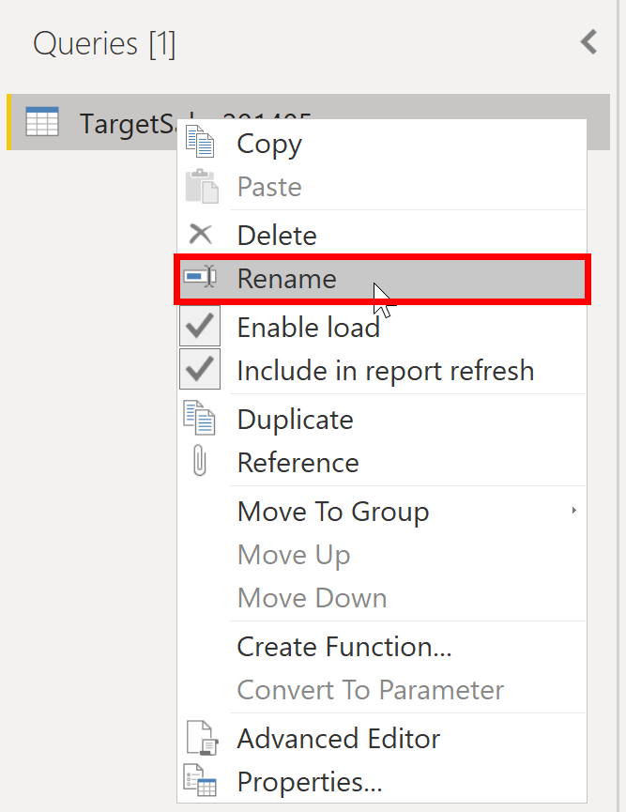
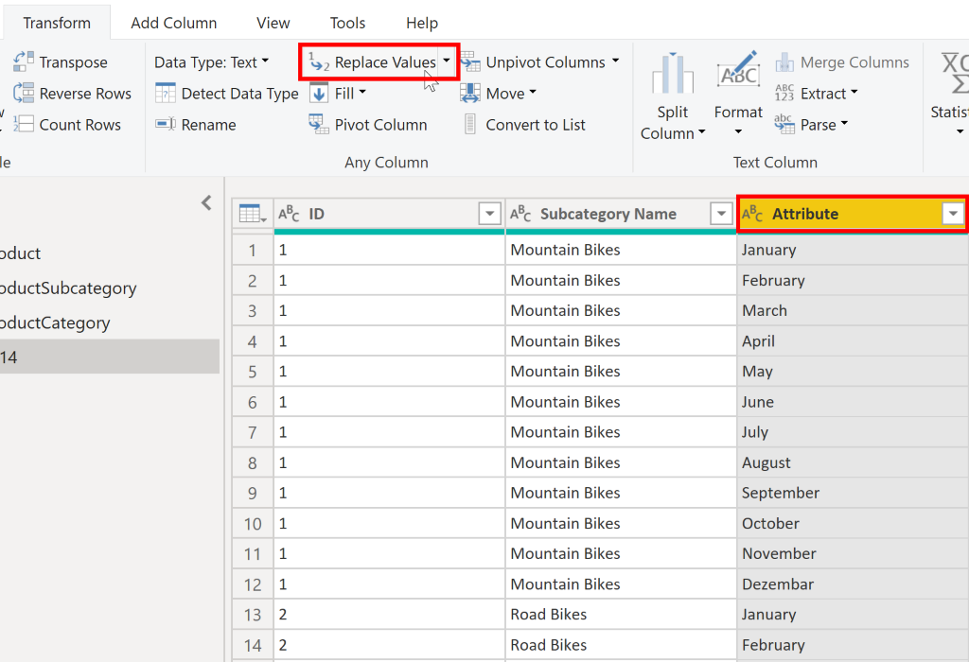
Apply user-friendly value replacements
As a best practice for naming conventions , give user friendly names to columns instead of abbreviated names
Make information user-friendly.
Notes:
When you import data from multiple sources into Power BI Desktop, the data retains its predefined table and column names. You might want to change some of these names so that they are in a consistent format, easier to work with, and more meaningful to a user. You can use Power Query Editor in Power BI Desktop to make these name changes and simplify your data structure.
Rename a query
It's good practice to change uncommon or unhelpful query names to names that are more obvious or that the user is more familiar with.
Replace values
You can use the Replace Values feature in Power Query Editor to replace any value with another value in a selected column.
Replace null values
Occasionally, you might find that your data sources contain null values.
Remove duplicates
You can also remove duplicates from columns to only keep unique names in a selected column.
Best practices for naming tables, columns, and values
A best practice is to give your tables, columns, and measures descriptive business terms and replace underscores ("_") with spaces. Be consistent with abbreviations, prefaces, and words like "number" and "ID." Excessively short abbreviations can cause confusion if they are not commonly used within the organization.

Slide 15
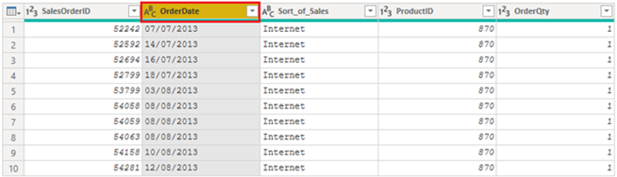
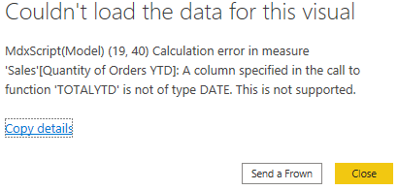
Evaluate and Change Column Data Types
Notes:
When you import a table from any data source, Power BI Desktop automatically starts scanning the first 1,000 rows (default setting) and tries to detect the type of data in the columns. Some situations might occur where Power BI Desktop does not detect the correct data type. Where incorrect data types occur, you will experience performance issues.
A best practice is to evaluate the column data types in Power Query Editor before you load the data into a Power BI data model. If you determine that a data type is incorrect, you can change it. You might also want to apply a format to the values in a column and change the summarization default for a column.
Implications of incorrect data types
Incorrect data types will prevent you from creating certain calculations, deriving hierarchies, or creating proper relationships with other tables.
<CLICK>
For example, if you try to calculate the Quantity of Orders YTD, you will get the following error stating that the OrderDate column data type is not Date, which is required in time-based calculations.
Change the column data type
You can change the data type of a column in two places: in Power Query Editor and in the Power BI Desktop Report view by using the column tools. It is best to change the data type in the Power Query Editor before you load the data.
As with any other changes that you make in Power Query Editor, the change that you make to the column data type is saved as a programmed step. This step is called Changed Type and it will be iterated every time the data is refreshed.

Slide 16
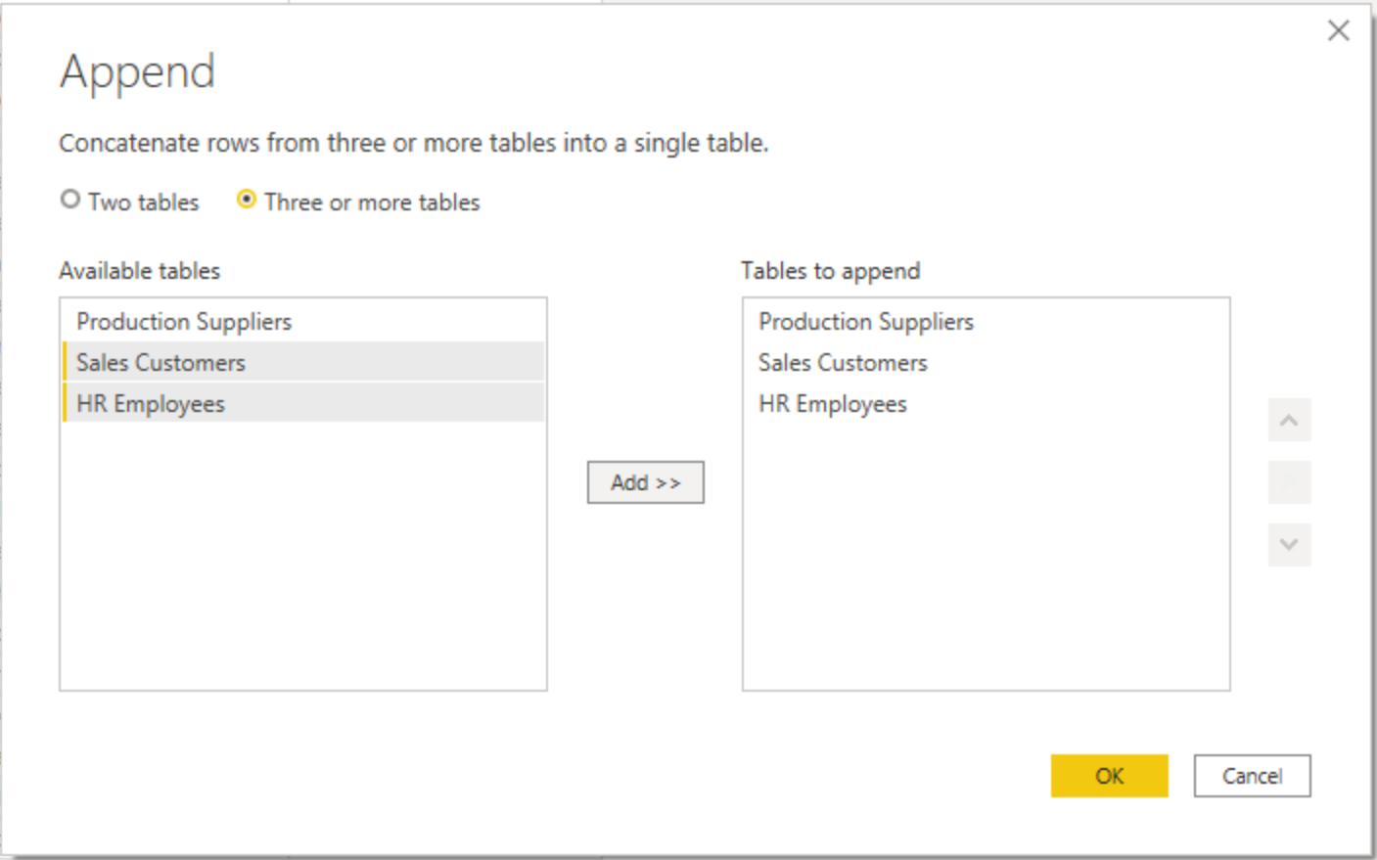
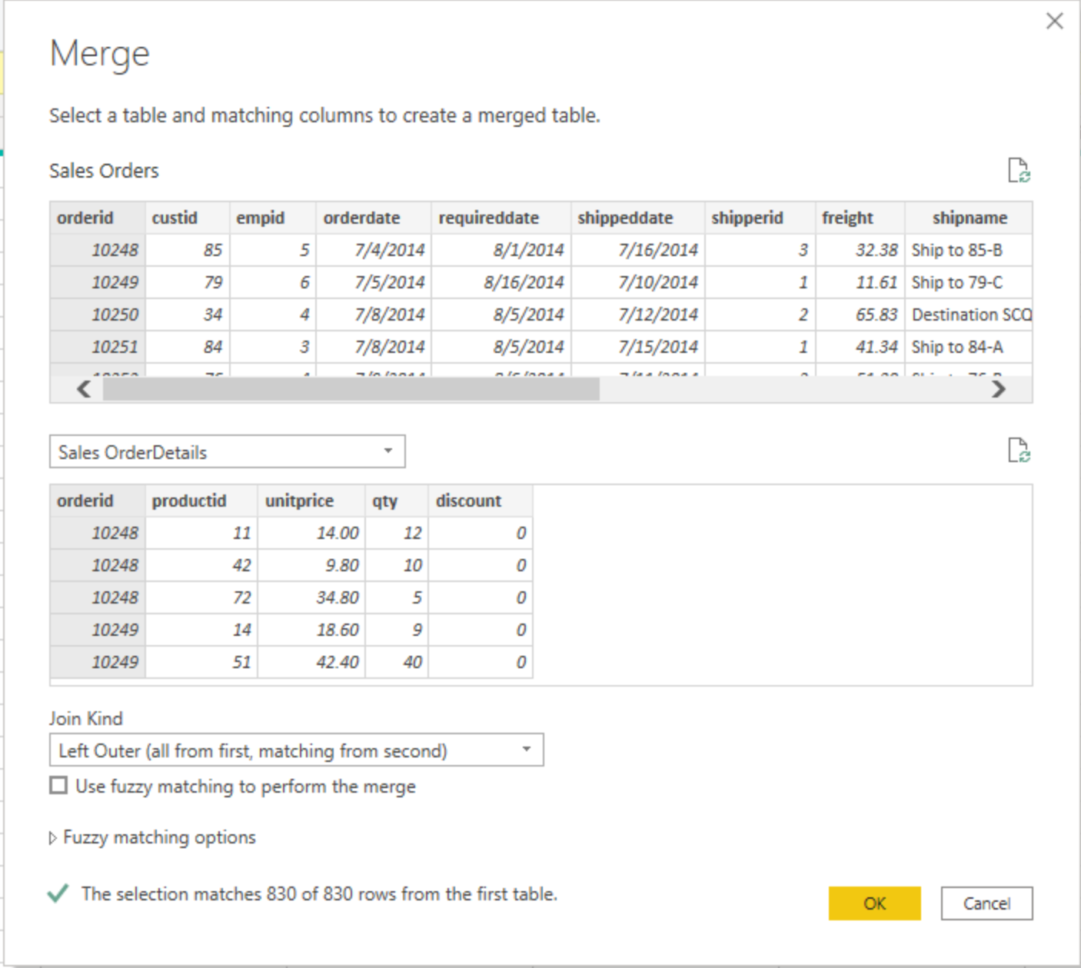
Combine Multiple Tables into a Single Table
Notes:
The ability to combine queries is powerful because it allows you to append or merge different tables or queries together. You can combine tables into a single table in the following circumstances:
Too many tables exist, making it difficult to navigate an overly-complicated data model.
Several tables have a similar role.
A table has only a column or two that can fit into a different table.
You want to use several columns from different tables in a custom column.
You can combine the tables in two different ways: merging and appending.
Append queries
When you append queries, you will be adding rows of data to another table or query.
Merge queries
When you merge queries, you are combining the data from multiple tables into one based on a column that is common between the tables. This process is similar to the JOIN clause in SQL.

Slide 17
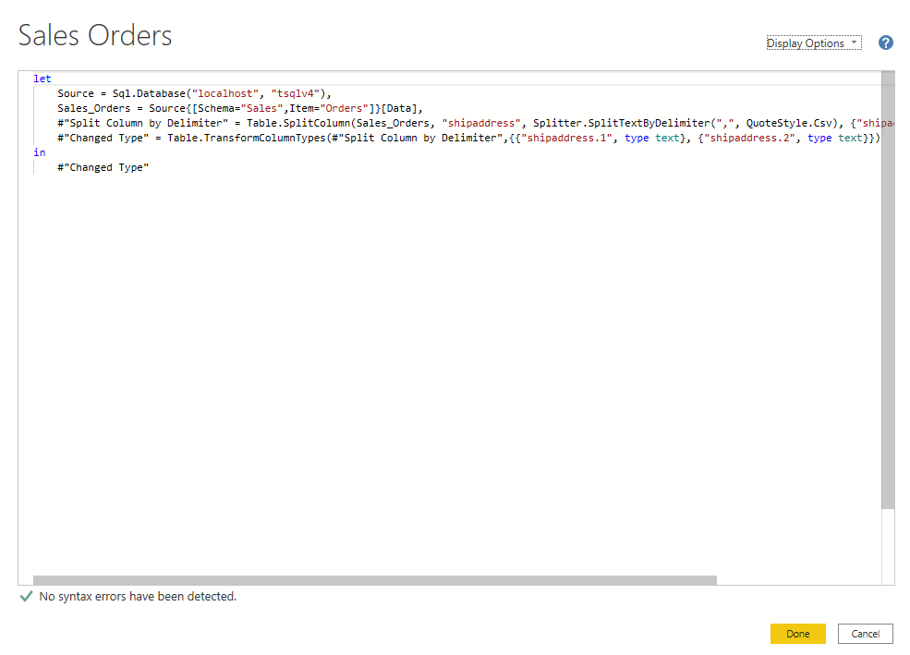
Use Advanced Editor to Modify M Code
See the code that Power Query Editor is creating with each step.
Notes:
Each time you shape data in Power Query, you create a step in the Power Query process. Those steps can be reordered, deleted, and modified where it makes sense. Each cleaning step that you made was likely created by using the graphical interface, but Power Query uses the M language behind the scenes. The combined steps are available to read by using the Power Query Advanced Editor. The M language is always available to be read and modified directly. It is not required that you use M code to take advantage of Power Query. You will rarely need to write M code, but it can still prove useful. Because each step in Power Query is written in M code, even if the UI created it for you, you can use those steps to learn M code and customize it to suit your needs.
Each Power Query step will roughly align with one or two lines of M code. You don't have to be an expert in M code to be able to read it. You can even experiment with changing it. For instance, if you need to change the name of a database, you could do it right in the code and then select Done.
You might notice that M code is written top-down. Later steps in the process can refer to previous steps by the variable name to the right of the equal sign. Be careful about reordering these steps because it could ruin the statement dependencies. Write to a query formula step by using the in statement. Generally, the last query step is used as the in final data set result.

Slide 18
Review Questions (2)
Q01 – What is not a best practice for naming conventions in Power BI?
A01 – Abbreviated column names
Q02 – What functionality lets you see the code that is generated as part of each transformation step?
A02 – Advanced Editor
Q03 – If you have two queries that contain different data with the same structure, and you want to combine them into one query, which operation should you perform?
A03 - Append

Slide 19
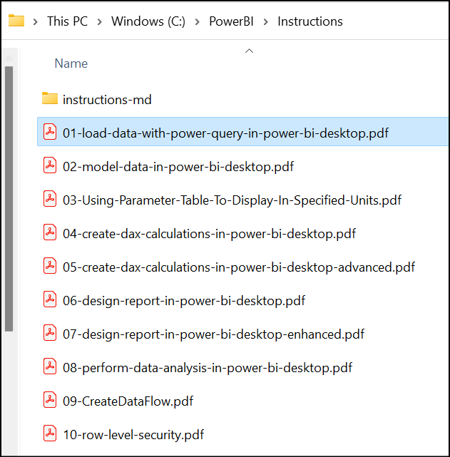
Lab: Load Data with Power Query in Power BI Desktop
Lab 01: Load Data with Power Query in Power BI Desktop

